Slide 1

SOFTWARE DESIGN AND CONSTRUCTION
CLOUD-NATIVE HOSTEL MANAGEMENT SYSTEM: ARCHITECTURE AND OPTIMIZATION
INSTRUCTOR:
Dr. Zunnurain
STUDENT NAMES:
ASMA HAIDER BSSE23051
UZAIR ABDULLAH BSSE23075

Slide 2
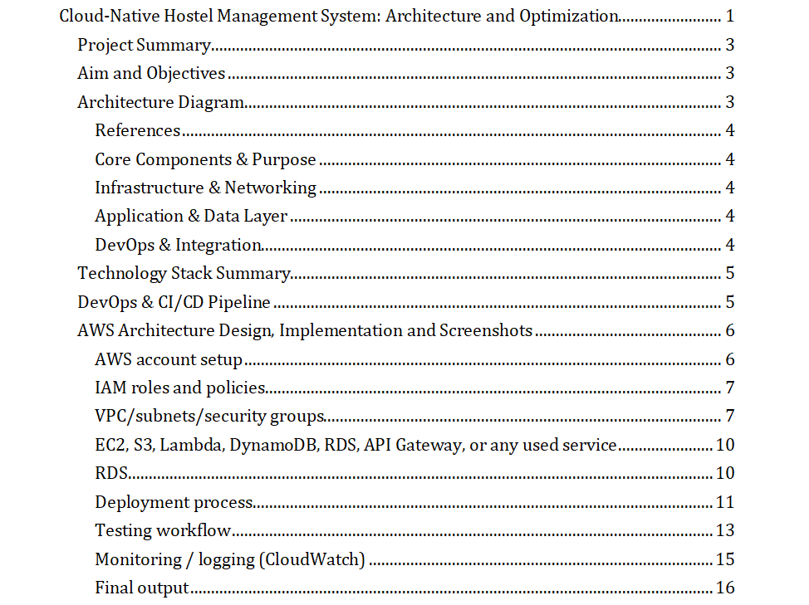
TABLE OF CONTENT
CLOUD-NATIVE LAYERED MONOLITHIC ARCHITECTURE

Slide 3
CHOSEN ARCHITECTURE STYLE - LAYERED MONOLITHIC (CLOUD-NATIVE) ARCHITECTURE
“THE APPLICATION IS DEPLOYED AS A SINGLE UNIT, AND ITS CODE IS ORGANIZED INTO LAYERS.”
This project involved the development and deployment of a containerized web application designed to modernize student record management and room allocation systems. By migrating from a legacy monolithic architecture to AWS Fargate, the solution leverages serverless container orchestration to ensure high availability and automated scaling without the overhead of managing underlying infrastructure.
A critical component of this modernization was addressing the challenge of ephemeral storage inherent in containerized environments; this was achieved by integrating cloud-native persistence layers, ensuring that critical student data and allocation records remain durable and consistent across container lifecycles

Slide 4
AIM AND OBJECTIVES
LEVERAGE A SERVERLESS CONTAINER STRATEGY TO ELIMINATE MANUAL INFRASTRUCTURE MANAGEMENT
MEDIA STORAGE IS EXTERNALIZED TO AMAZON S3 FOR DURABLE OBJECT MANAGEMENT,
DEPLOYING RESOURCES ACROSS
MULTI-AVAILABILITY ZONES
BULK UPLOAD FEATURE FOR PROCESSING LARGE DATASETS VIA EXCEL.

Slide 5
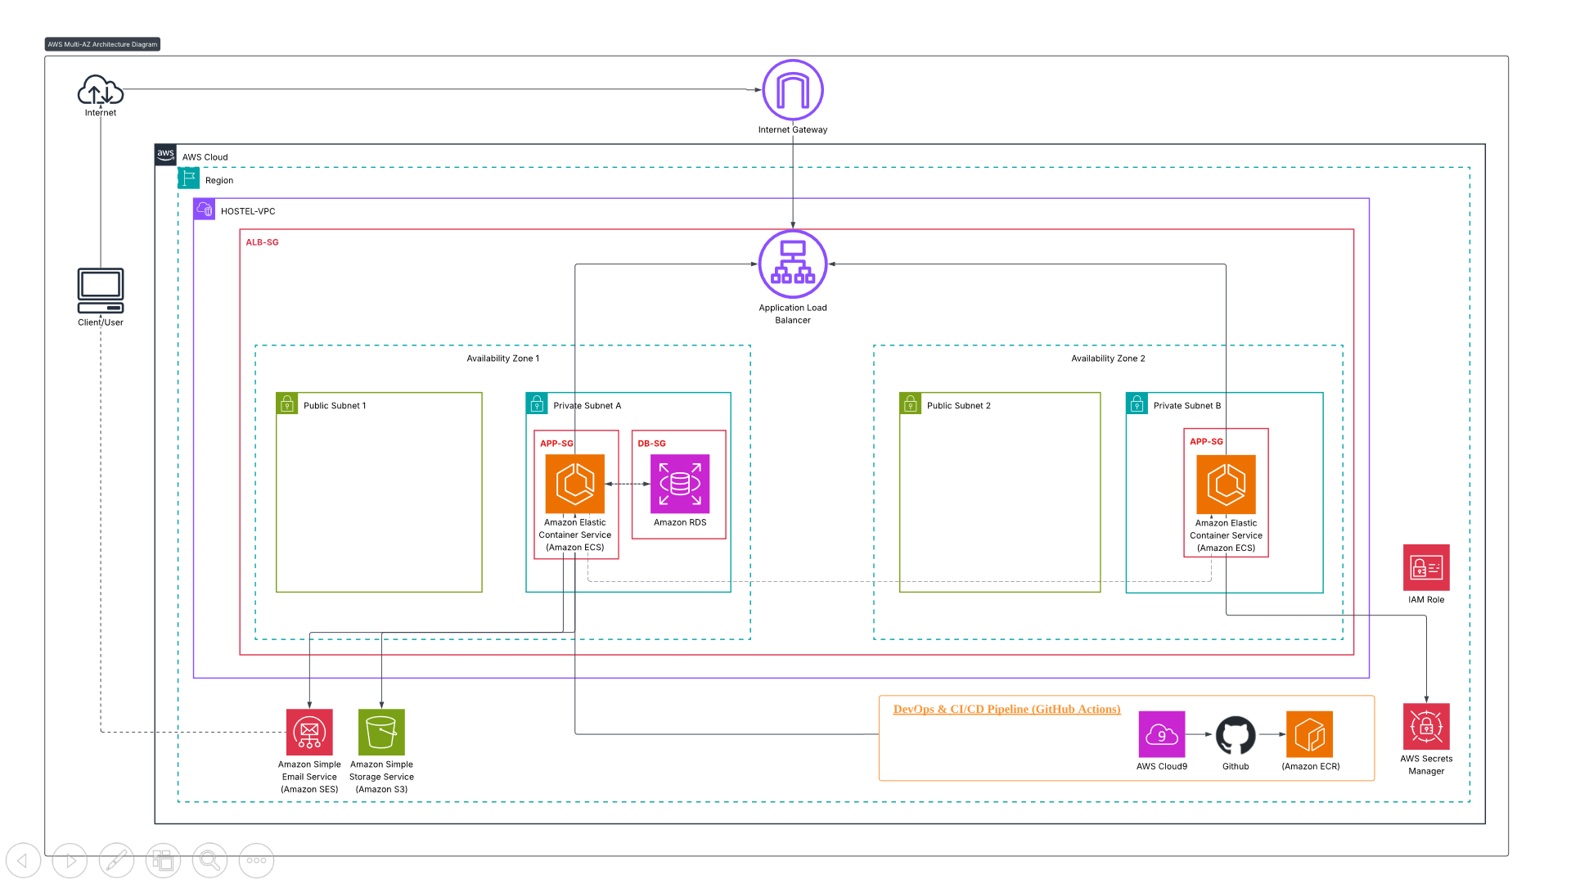
ARCHITECTURE DIAGRAM

Slide 6
IMPLEMENTATION
CORE COMPONENTS & PURPOSE
01
02
03
VPC (VIRTUAL PRIVATE CLOUD)
PUBLIC SUBNETS
PRIVATE SUBNETS
Provides a logically isolated section of the AWS Cloud where you can launch AWS resources in a defined virtual network.
Host the Application Load Balancer (ALB), which acts as the single point of contact for clients and distributes incoming application traffic across multiple targets.
Host the application containers and database instances, shielding them from direct internet access for enhanced security.
04
05
AVAILABILITY ZONES (AZ1 & AZ2)
AMAZON ECS (ELASTIC CONTAINER SERVICE)
Ensure high availability and fault tolerance; if one AZ fails, the application remains operational in the other.
Orchestrates and runs containerized applications (often using AWS Fargate for serverless management).

Slide 7
06
07
AMAZON RDS (RELATIONAL DATABASE SERVICE)
AMAZON S3
A managed database service that, in this "Multi-AZ" setup, maintains a primary instance in one AZ and a standby in another for automatic failover
Used for scalable object storage, typically for static assets or backups.
08
09
10
AWS SECRETS MANAGER
AWS CLOUD9
SMTP (SIMPLE MAIL TRANSFER PROTOCOL)
Securely stores and manages sensitive information like database credentials and API keys
A cloud-based IDE used by developers to write, run, and debug code directly within the AWS environment
A standard email sending service used by the application to send notifications or transactional emails through an email server

Slide 8

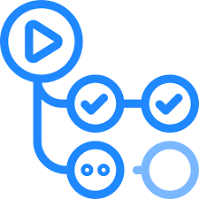


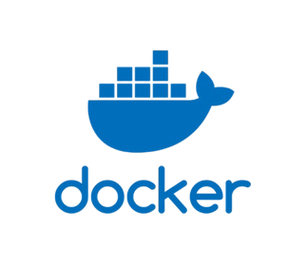
11
10
GITHUB ACTIONS
AMAZON ECR (ELASTIC CONTAINER REGISTRY)
Automates the CI/CD workflow, triggering builds and deployments whenever code changes are pushed to the repository.
A fully managed Docker container registry used to store and manage container images.
GITOPS WORKFLOW
Push
Build &Test
Image Push
Deploy
Automated the delivery pipeline where code commits trigger immediate builds and zero-downtime deployments to AWS ECS

Slide 9
DEVOPS & INTEGRATION
GITHUB ACTIONS
Automates the CI/CD workflow, triggering builds and deployments whenever code changes are pushed to the repository
Amazon ECR (ElastIC CONTAINER REGISTRY)
A fully managed Docker container registry used to store and manage container images.
AWS CLOUD9
A cloud-based IDE used by developers to write, run, and debug code directly within the AWS environment.

Slide 10
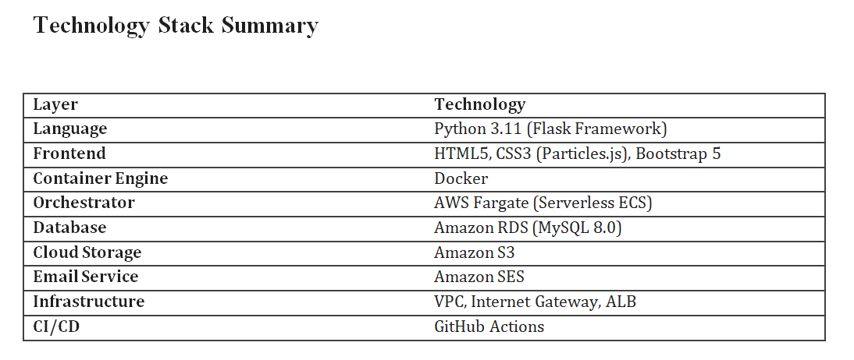

Slide 11

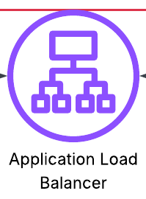





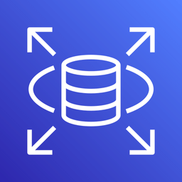

TOOLS & PLATFORM USED
Github
SM
ALB
ECR
IAM
IG
S3
Cloud9
RDS
ECS

Slide 12
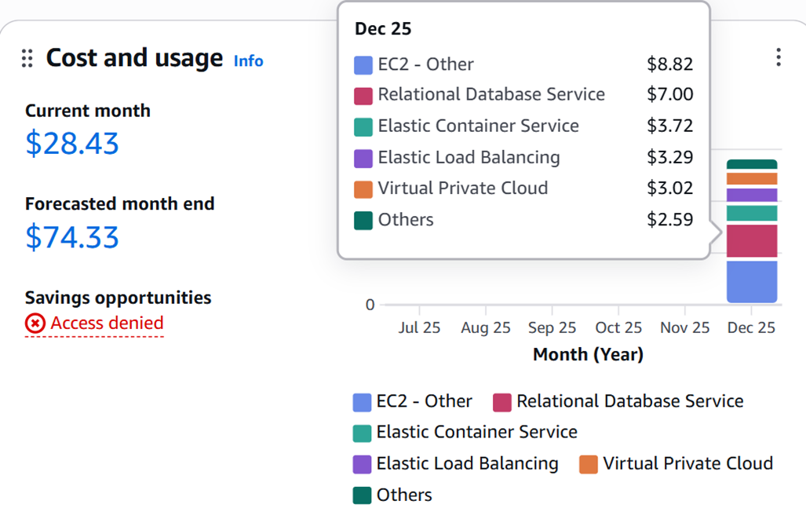
RESULTS
AWS
COST AND USAGE
The dashboard is summarizing cloud spending for the current month, with a total cost of $28.43 so far and a forecasted month-end cost of $74.33, broken down by services such as EC2, RDS, ECS, Elastic Load Balancing, and VPC.

Slide 13
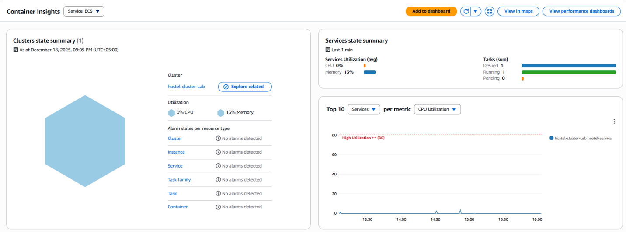
RESULTS

Slide 14
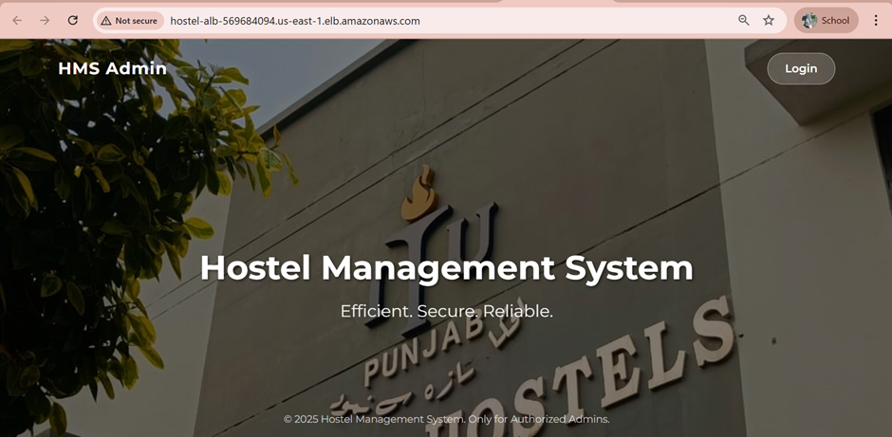
RESULTS

Slide 15
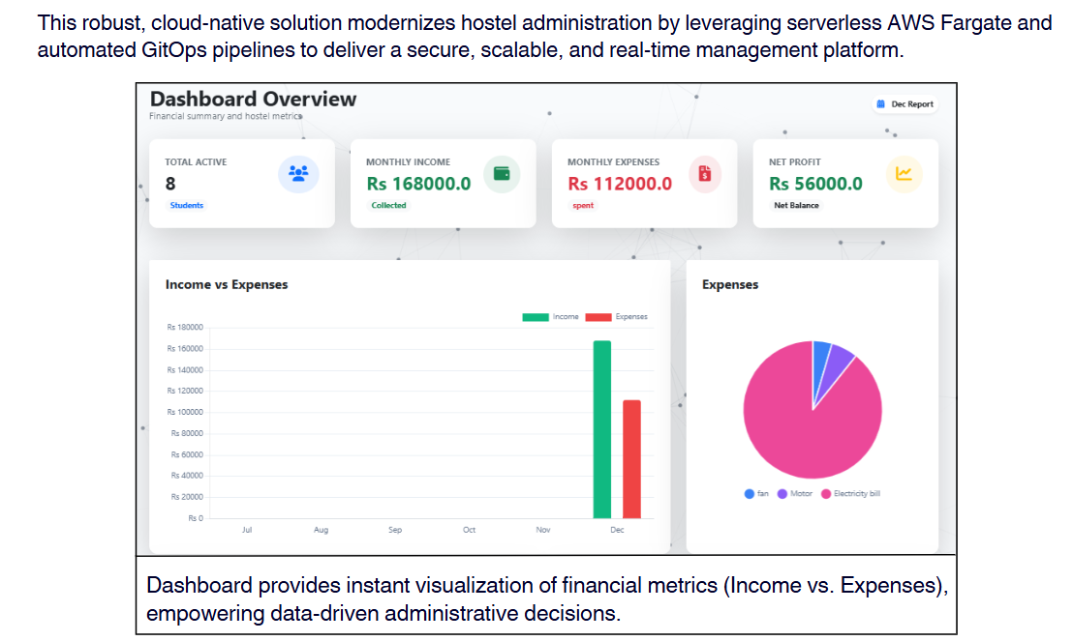
RESULTS

Slide 16
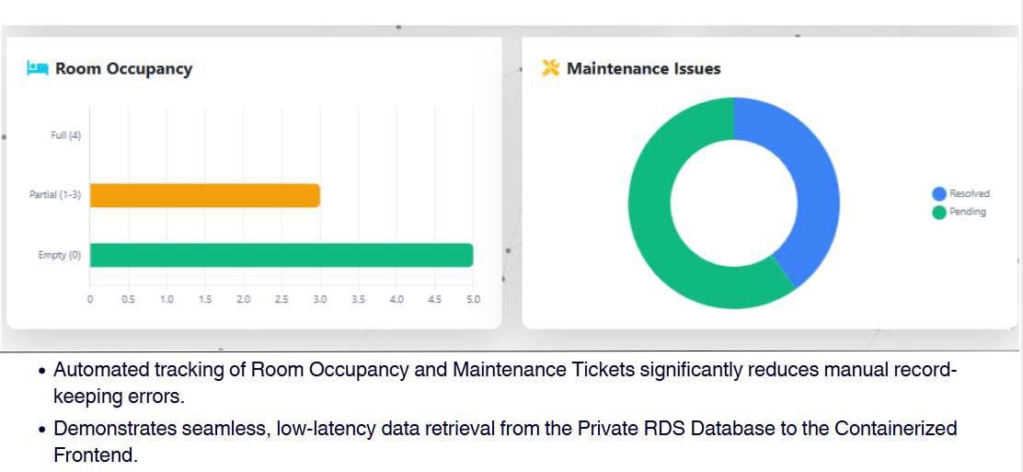
RESULTS

Slide 17
THANKYOU
REFRENCES
AMAZON WEB SERVICES (AWS) DOCUMENTATION - ECS & FARGATE.
Docker Inc. - Containerization Best Practices.
FLASK FRAMEWORK DOCUMENTATION (PALLETS PROJECTS).
GITOPS PRINCIPLES & GITHUB ACTIONS GUIDES.

